Slide 1


What is Computer?

Slide 2
List of Concepts Involved:
What is a Computer?
Features of Computer
Components of Computer
I/O(Input/Output)
CPU
RAM
Hard Disk/ SSD

Slide 3
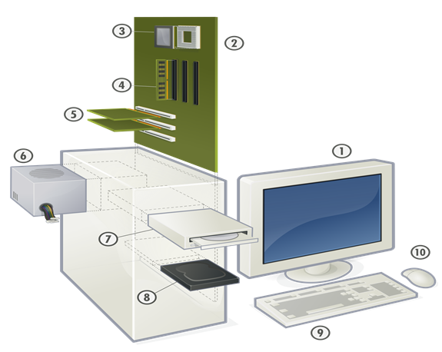
What is Computer?
A computer is a piece of electronic equipment that stores and processes data, often in binary form, in accordance with commands from a variable programme.

Slide 4
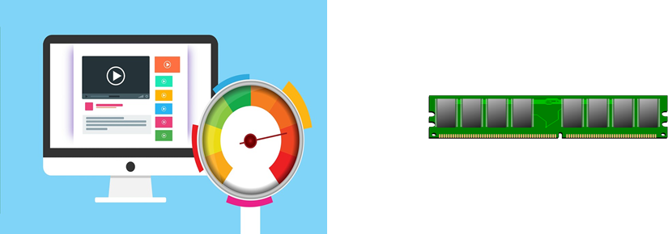
Features of Computer
Speed
Accuracy
Diligence
Versatility
Reliability
Memory

Slide 5
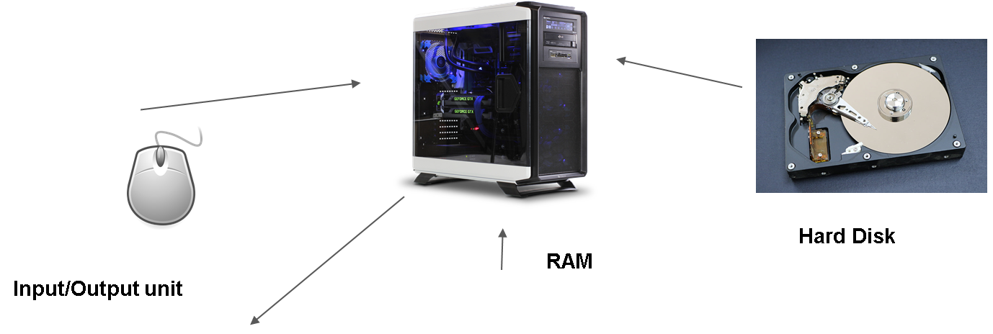
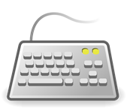
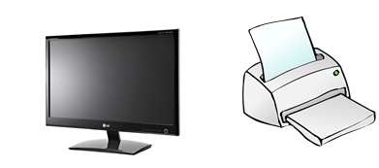
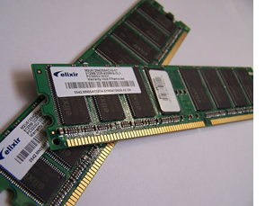
Components of Computer
CPU

Slide 6
THANK YOU

